Slide 1
Intelligent Diagnosis of Cardiac Disease Prediction using Machine Learning
Under the Guidance of Assistant Prof….

Slide 2
Abstract
Cardiac disease have become worldwide common public health issue, mainly due to lack of awareness of health, poor lifestyle and poor consumption
Typical disease the amount of information available is so massive that it can be difficult to make accurate and reliable decisions .
We developed a framework in this exploration that can understand the principles of predicting the risk
Three machine learning algorithms were used to compare performance measurements to cardiac diseases identification

Slide 3
Introduction
Healthcare systems have dramatically increased human life expectancy
the health support systems are currently facing significant challenges with general healthcare
An estimated 23.6 million persons will be diagnosed as having heart disease by 2030 according to the World Health Organization.
In order to detect, analyze, and predict various diseases, the ML techniques are more effective .
One important goal is the efficiency of disease identification and a reduction of mortality caused by heart disease and prevention

Slide 4
Literature Survey
The Rule-base approach to efficient prediction of cardiac disorders .
Heart Disease Classification with forward heart network Algorithms using Clever Land Sets .
Cardiovascular risk prediction model development and validation using NIPPON DATA
Van Calster has proposed a prediction model assessment
approach

Slide 5
Existing System
heart disease was thought to be the problem of developed countries.
heart disease was considered to be a man’s problem, but now it is recognized as number one killer of women, just as it is of men.
The test also can identify areas of heart muscle that aren't contracting normally due to poor blood flow or injury from a previous heart attack.

Slide 6
Proposed system
The general objective of this study is to design a predictive model for heart disease detection .
capable of enhancing the reliability of heart disease diagnosis using echocardiography.
The process starts with determining the KDD goals, and ends with the implementation of the discovered knowledge.

Slide 7
Advantages of Proposed System
To identify key patterns or features from the dataset.
To Identify and select attributes that are more relevant in relation to heart disease diagnosis.
To compare Decision Tree, Support Vector Machines and Bayesian Classifiers in predicting heart disease cases.
To interpret and analyze the results of the selected model with the help of domain expert.

Slide 8
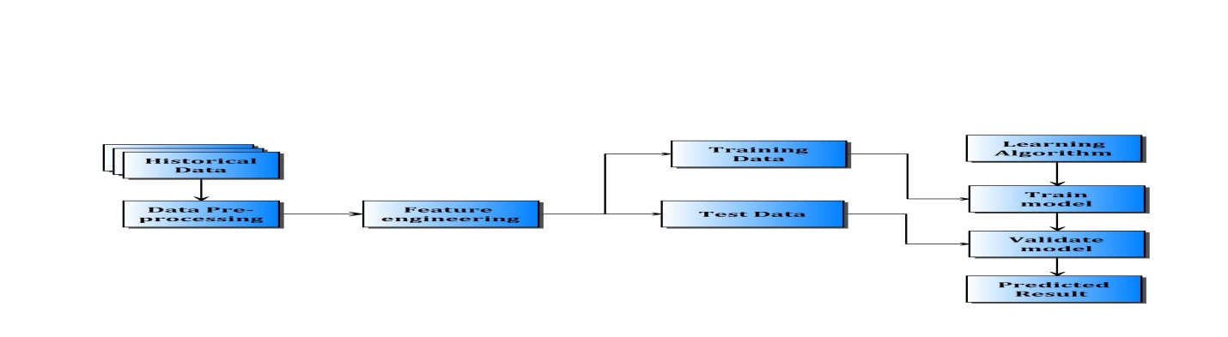
Design(System Architecture)
Fig. System Architecture

Slide 9
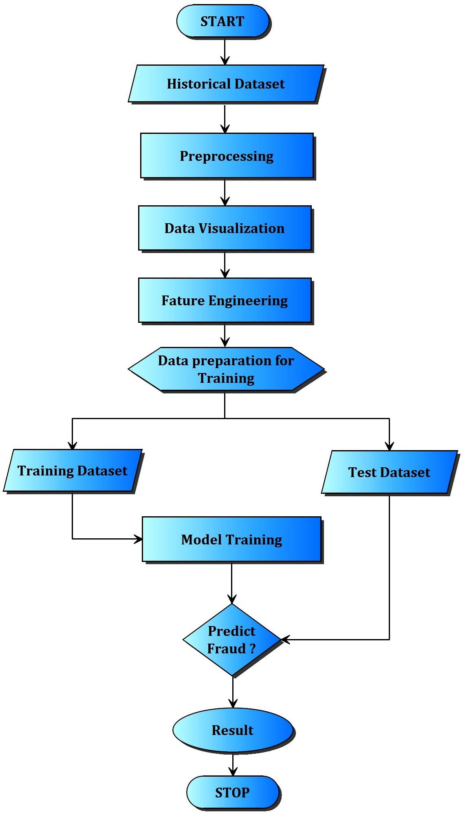
Flow Diagrams

Slide 10
Development: Algorithms Used
Machine learning techniques have the ability to train and test the data using the raw data.
We would like to investigate how well these algorithms perform with respect to our datasets.
Logistic Regression is a classification algorithm used as predictive analysis which determines the presence of Cardiac Diseases.
Naïve Bayes technique is used as a classifier algorithm which classifies the diseases based on the parameters in medical diagnosis.
ID3 algorithm is mainly used as a classifier in supervised learning

Slide 11
Implementation
Python is an easy to learn, powerful programming language. .
The Python interpreter and the extensive standard library are freely available in source or binary form for all major platforms .
Decision tree:
Decision Tree algorithm belongs to the family of supervised learning algorithms. Unlike other supervised learning algorithms, decision tree algorithm can be used for solving regression and classification problems too.
The general motive of using Decision Tree is to create a training model which can use to predict class or value of target variables by learning decision rule inferred from prior data(training data).

Slide 12
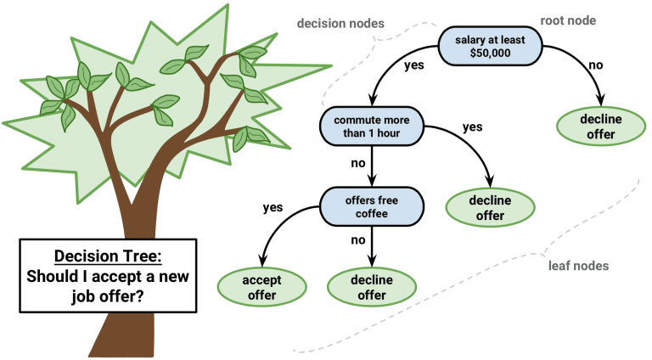
Implementation
Decision Tree Algorithm Pseudocode
Place the best attribute of the dataset at the root of the tree.
Split the training set into subsets. Subsets should be made in such a way that each subset contains data with the same value for an attribute.
Repeat step 1 and step 2 on each subset until you find leaf nodes in all the branches of the tree.

Slide 13
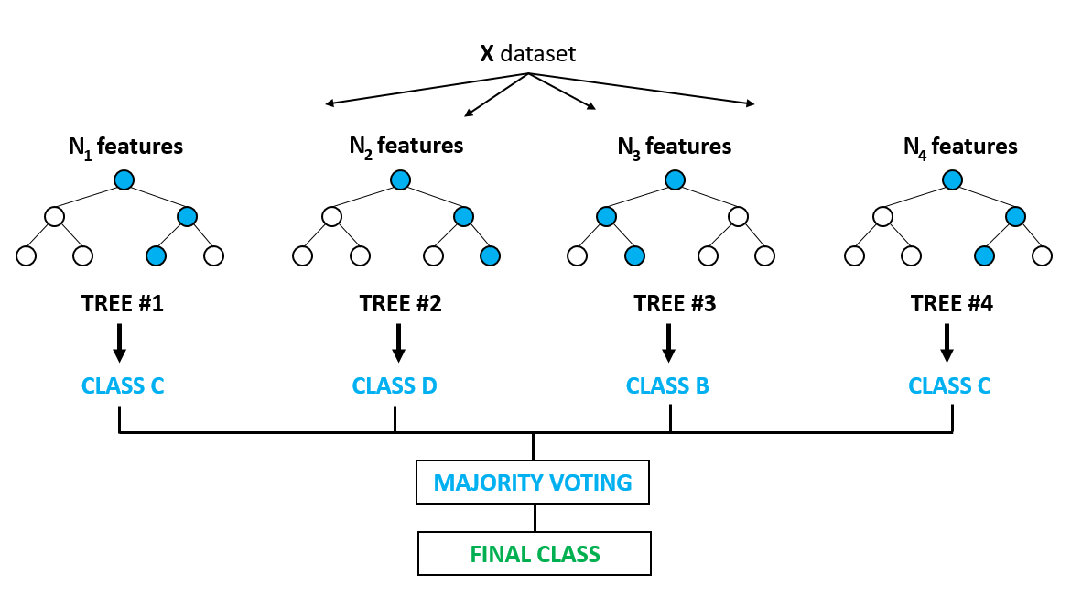
Implementation

Slide 14
Results
We compare the performance of diseased samples taken by Logistic Regression, Naïve Bayes, ID3 algorithms.
This section examines the methods chosen to assess performance, stability and scalability.
Logistic Regression: Accuracy= 81.86
Naive Bayes : Accuracy= 61.46

Slide 15
Conclusion
Proposes a model to recognize cardiac diseases using a machine learning approach based on regularized logistic regression, Naïve Bayes and SVM.
The results obtained confirm that the algorithm of neural networks competes strongly against these algorithms in the detection of diseases according to the data set presented.
the accuracy of our logistic regression is 87.2 percent, while the other algorithms are less exact than the other algorithms used.

Slide 16
References
Kanak Saxenab, Richa Sharmac, Efficient Heart Disease Prediction System Vol :85, pp: 962 – 969, (2018).
J. Nahar, “Computational intelligence for heart disease diagnosis: A medical knowledge driven approach”.
A.J. Vickers, B. Van Calster, E.W. Steyerberg, Net benefit approaches to the evaluation of prediction models, molecular markers, and diagnostic tests, BMJ 352 (2016).
Frontile Solver Training on Artifical Neural Network Jan 17(2017).

Slide 17
Thank you

